Slide 1
Comparison of ES50/100 CONUS Maps
Dec 15, 2022
Questions to sformel@usgs.gov

Slide 2
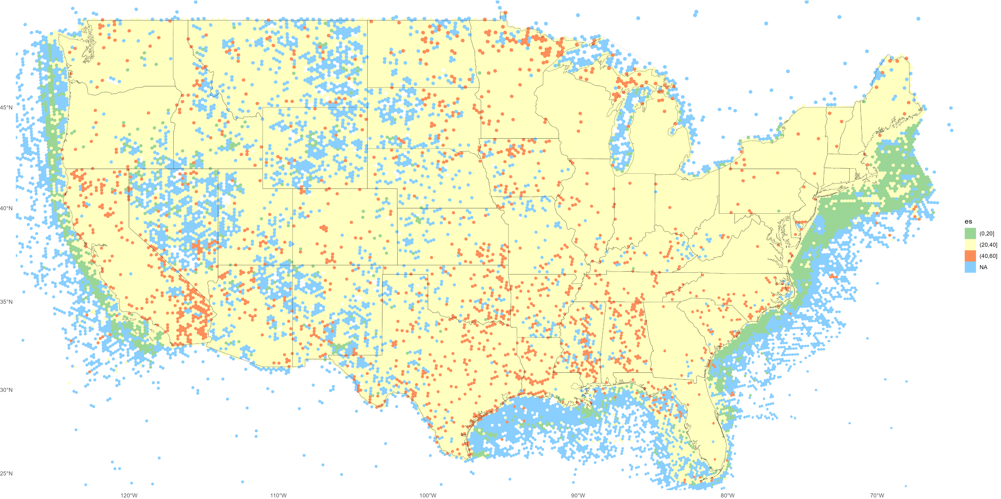
2010s, res 5. ES50 GBIF + OBIS

Slide 3
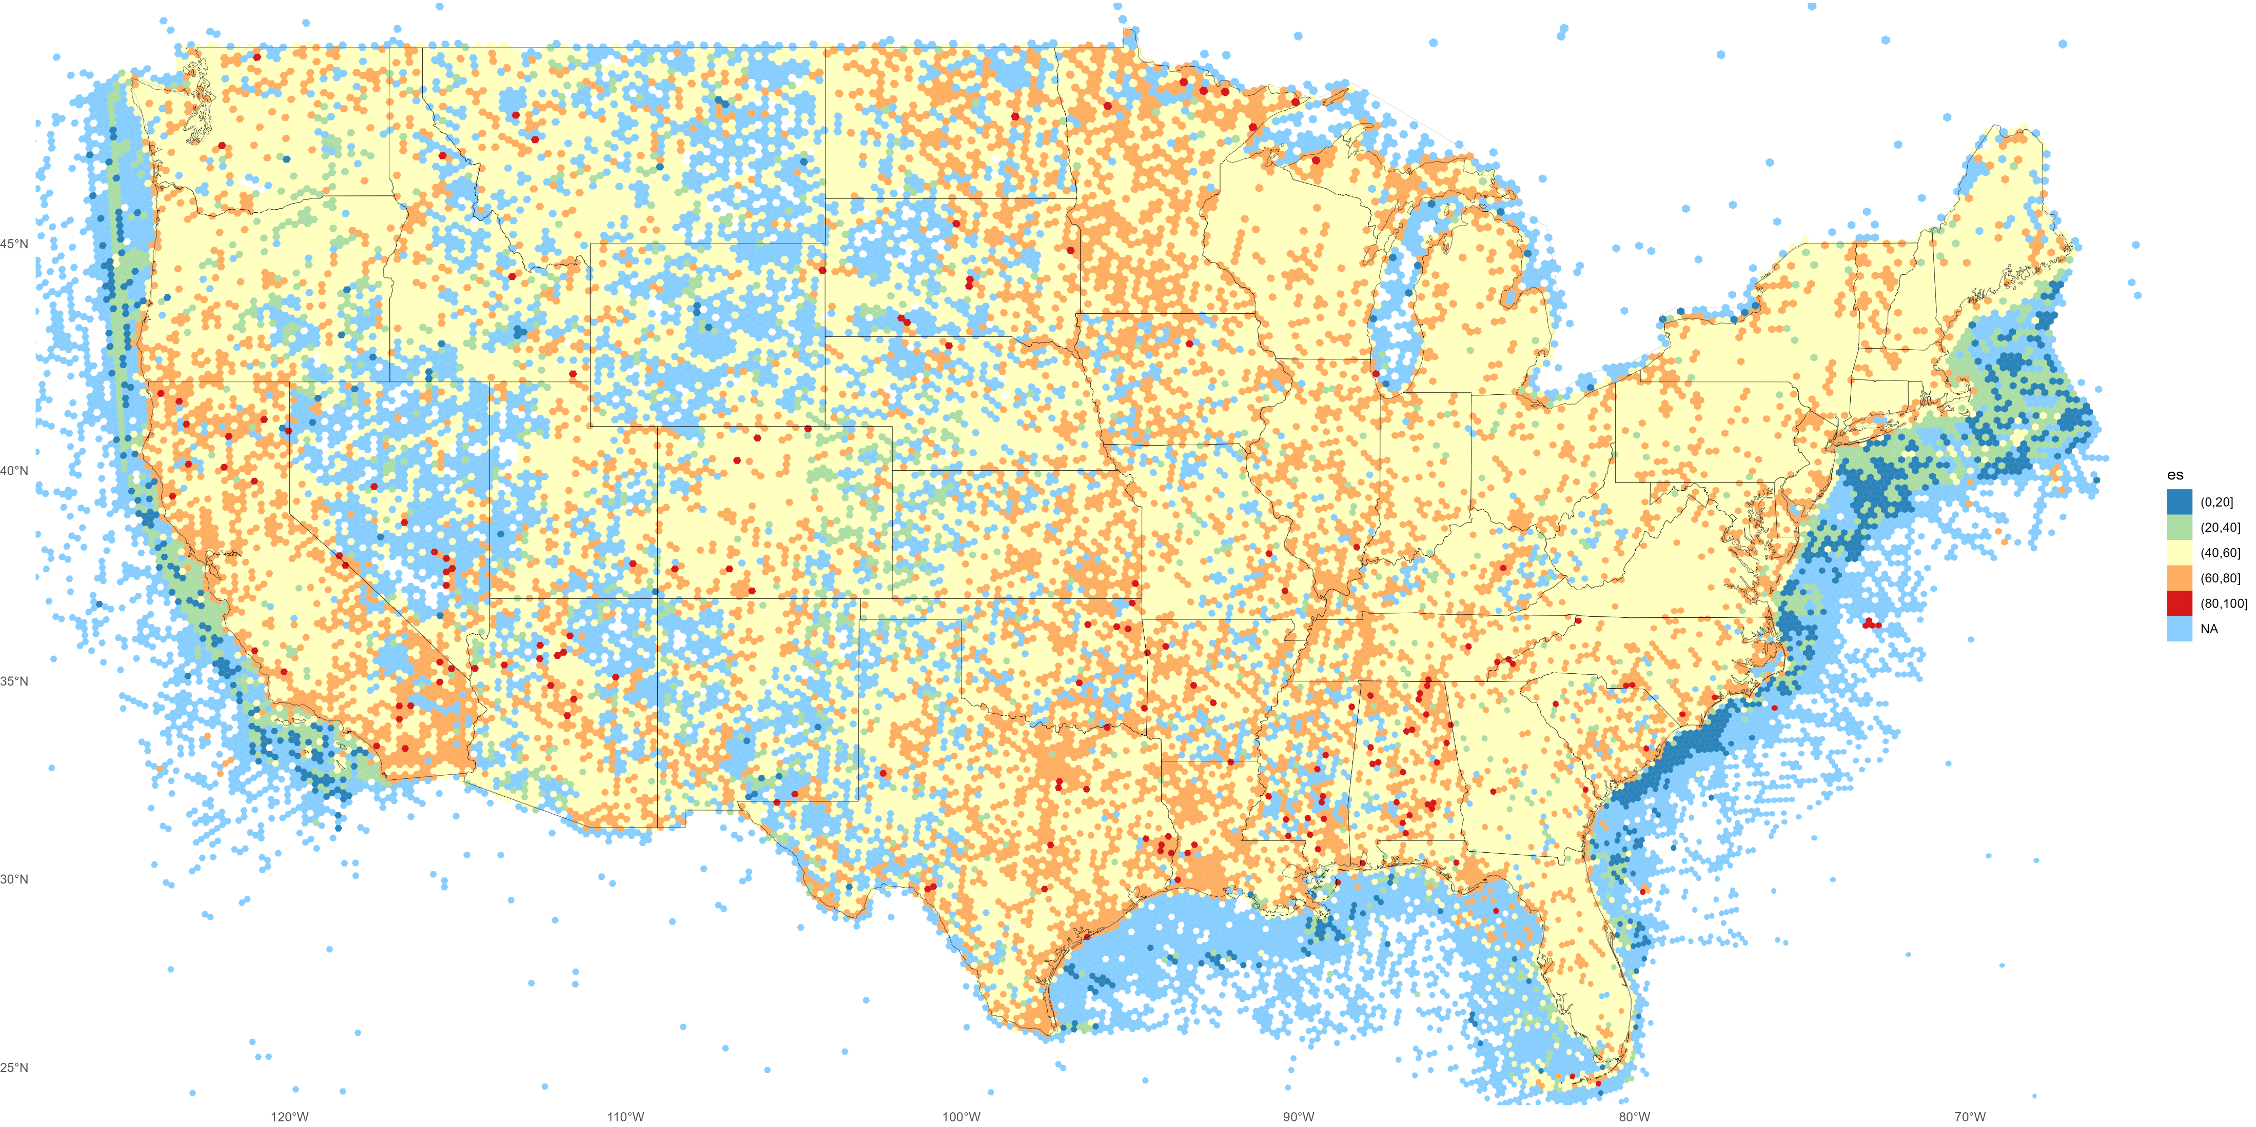
2010s, res 5. ES100 GBIF + OBIS

Slide 4

2010s, res 5. ES100 GBIF only

Slide 5
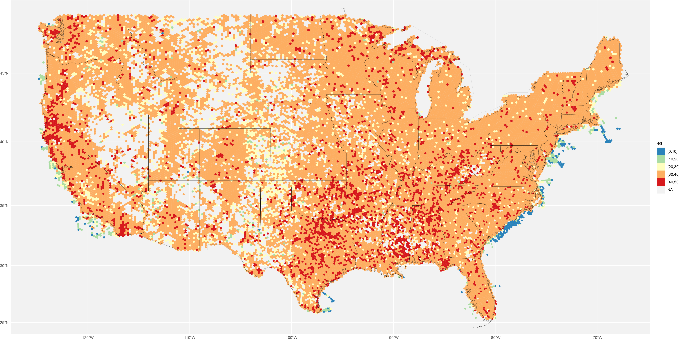
2010s, res 5. ES50 GBIF only (clipped to CONUS bounding box)

Slide 6
Comparison of ES50 CONUS Maps
Dec 8, 2022
Questions to sformel@usgs.gov

Slide 7
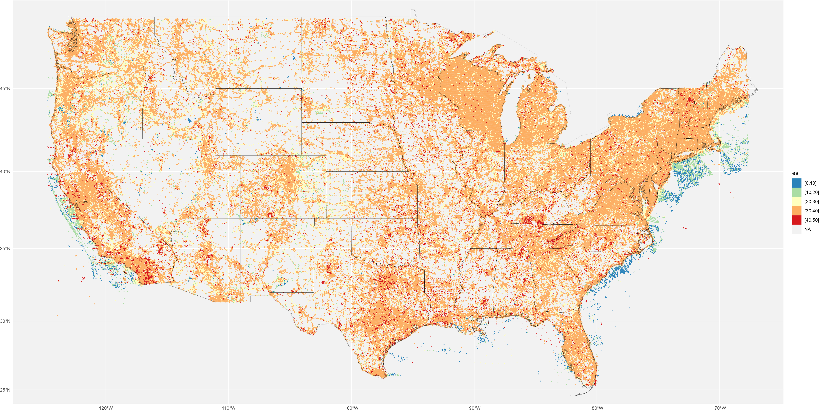
2010s, res 6. ES50

Slide 8
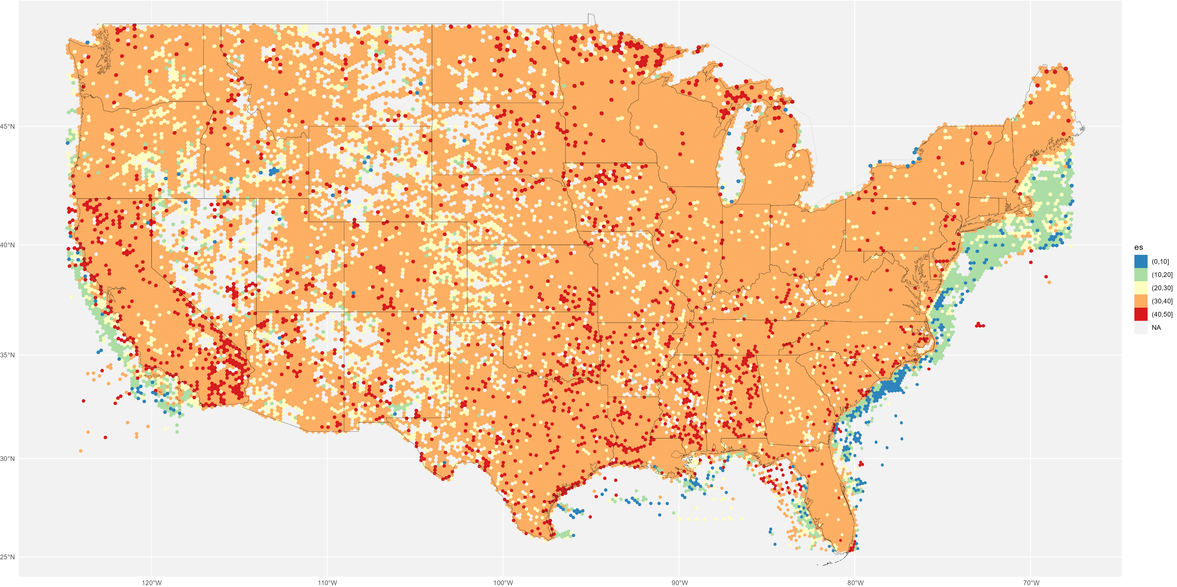
2010s, res 5. ES50

Slide 9
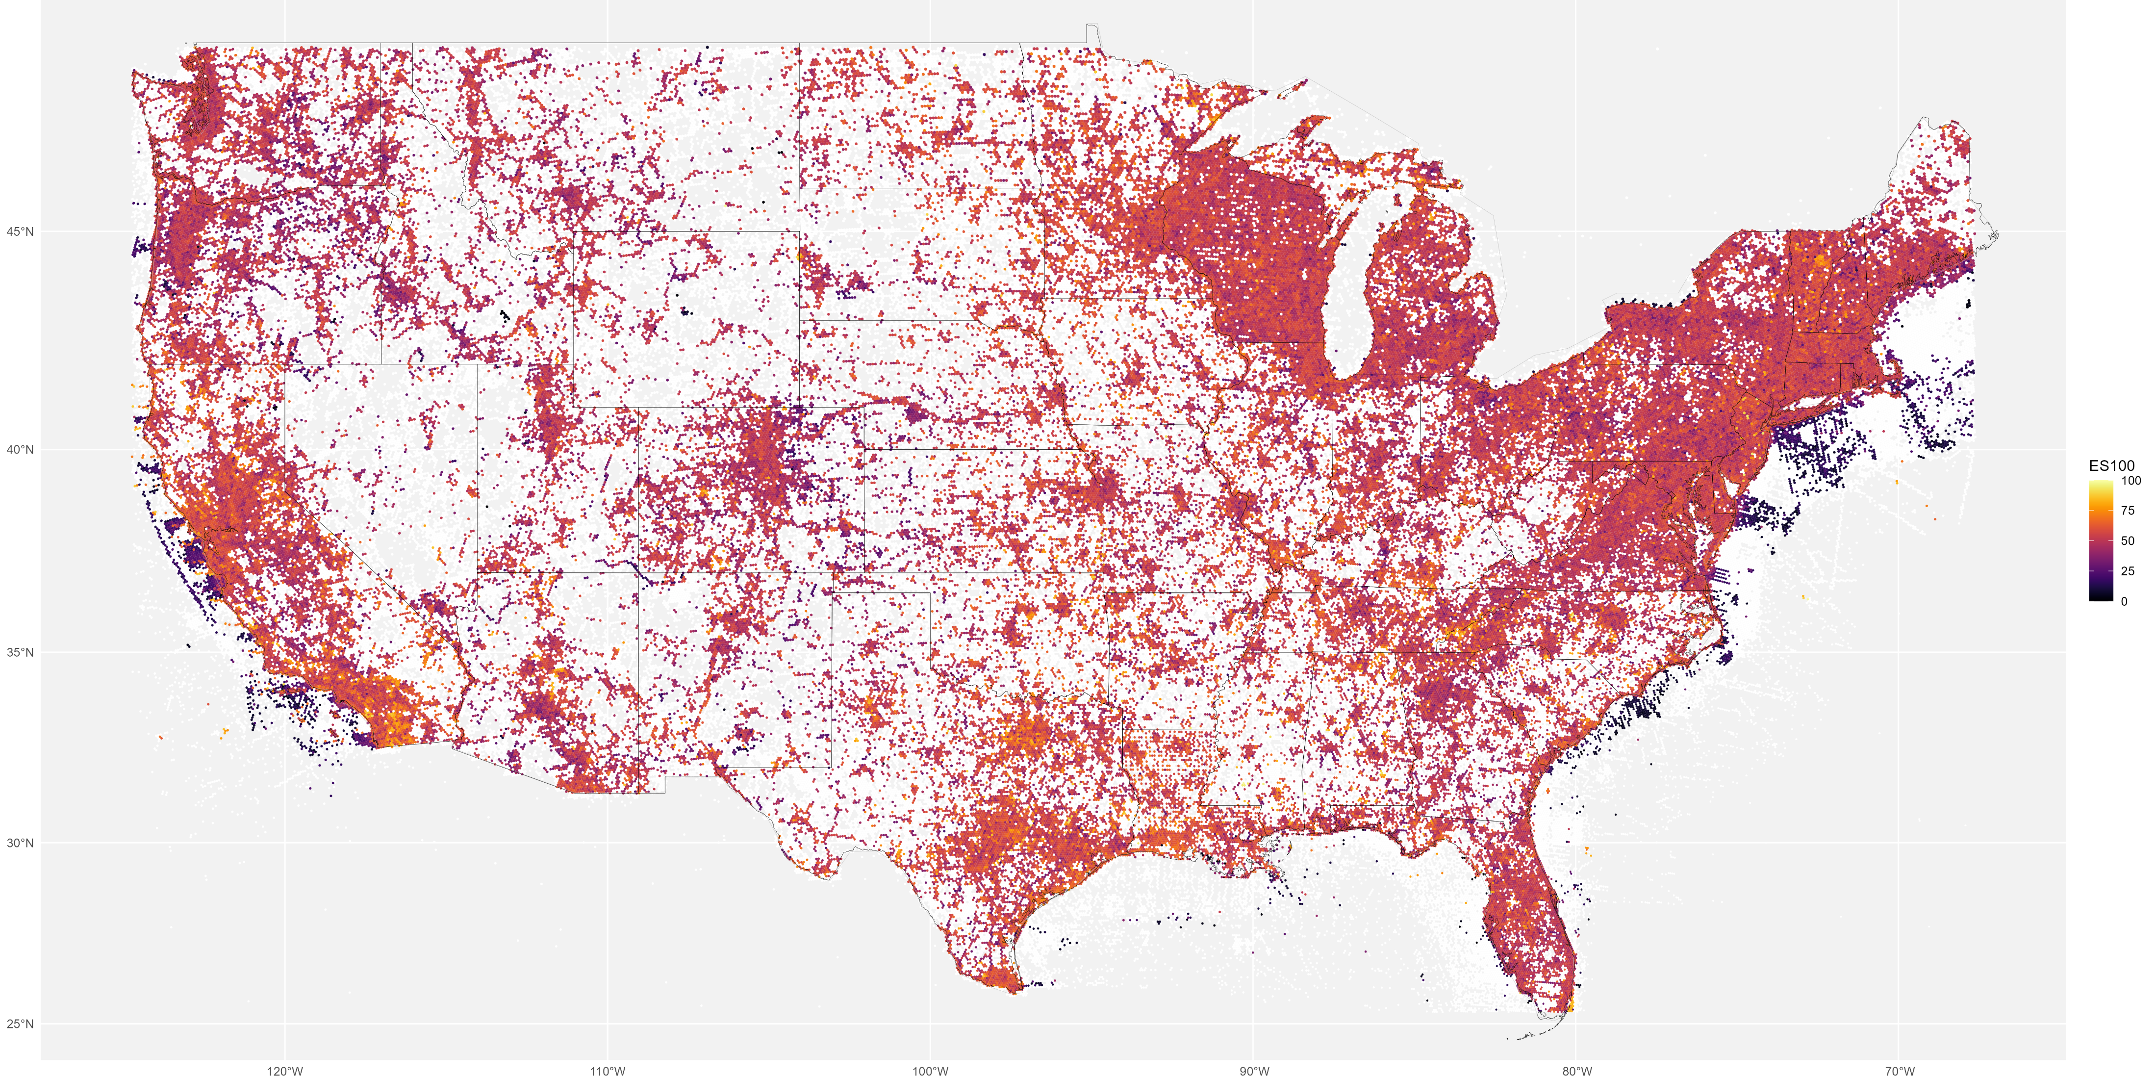
2010s, res 6. ES50 continuous color

Slide 10
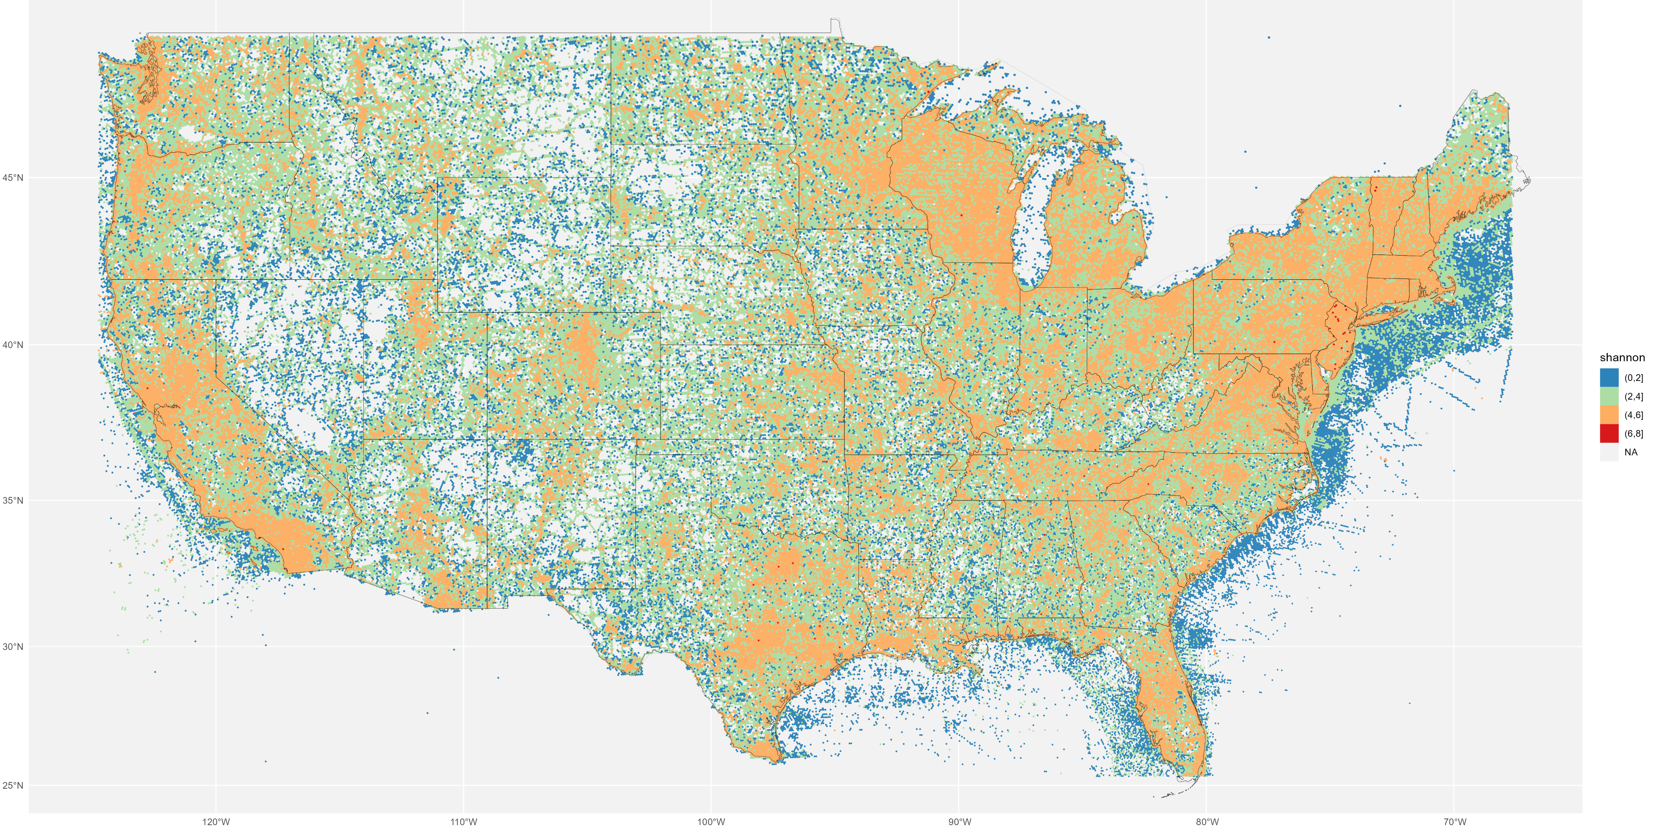
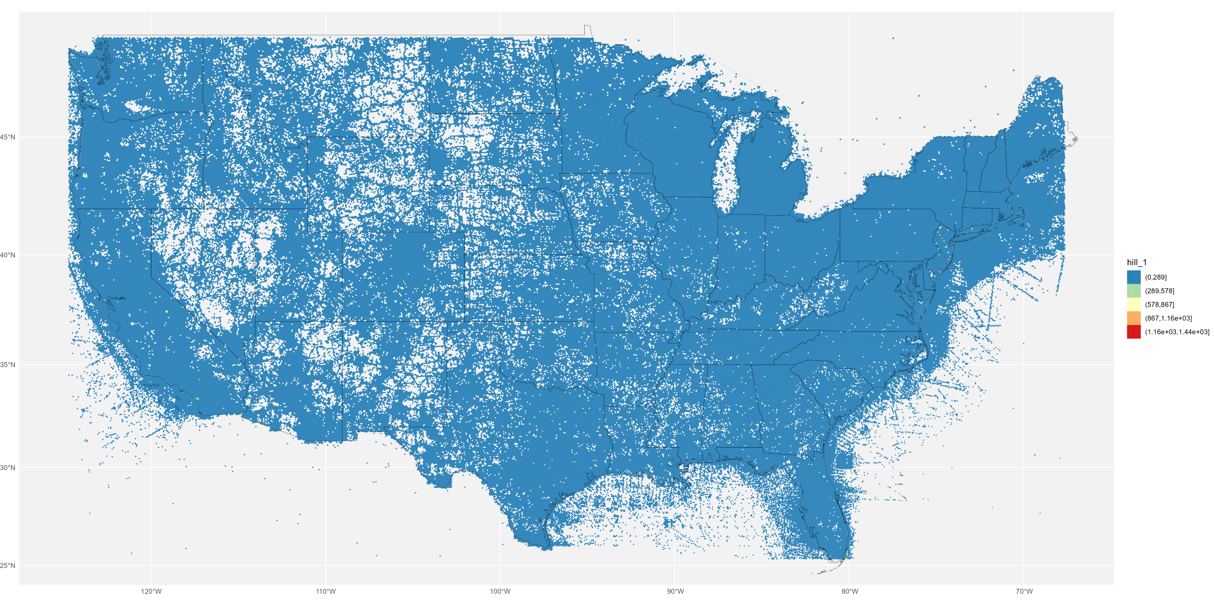
2010s, res 6. left to right: ES50, Shannon, Hill 1 (on bottom)

Slide 11
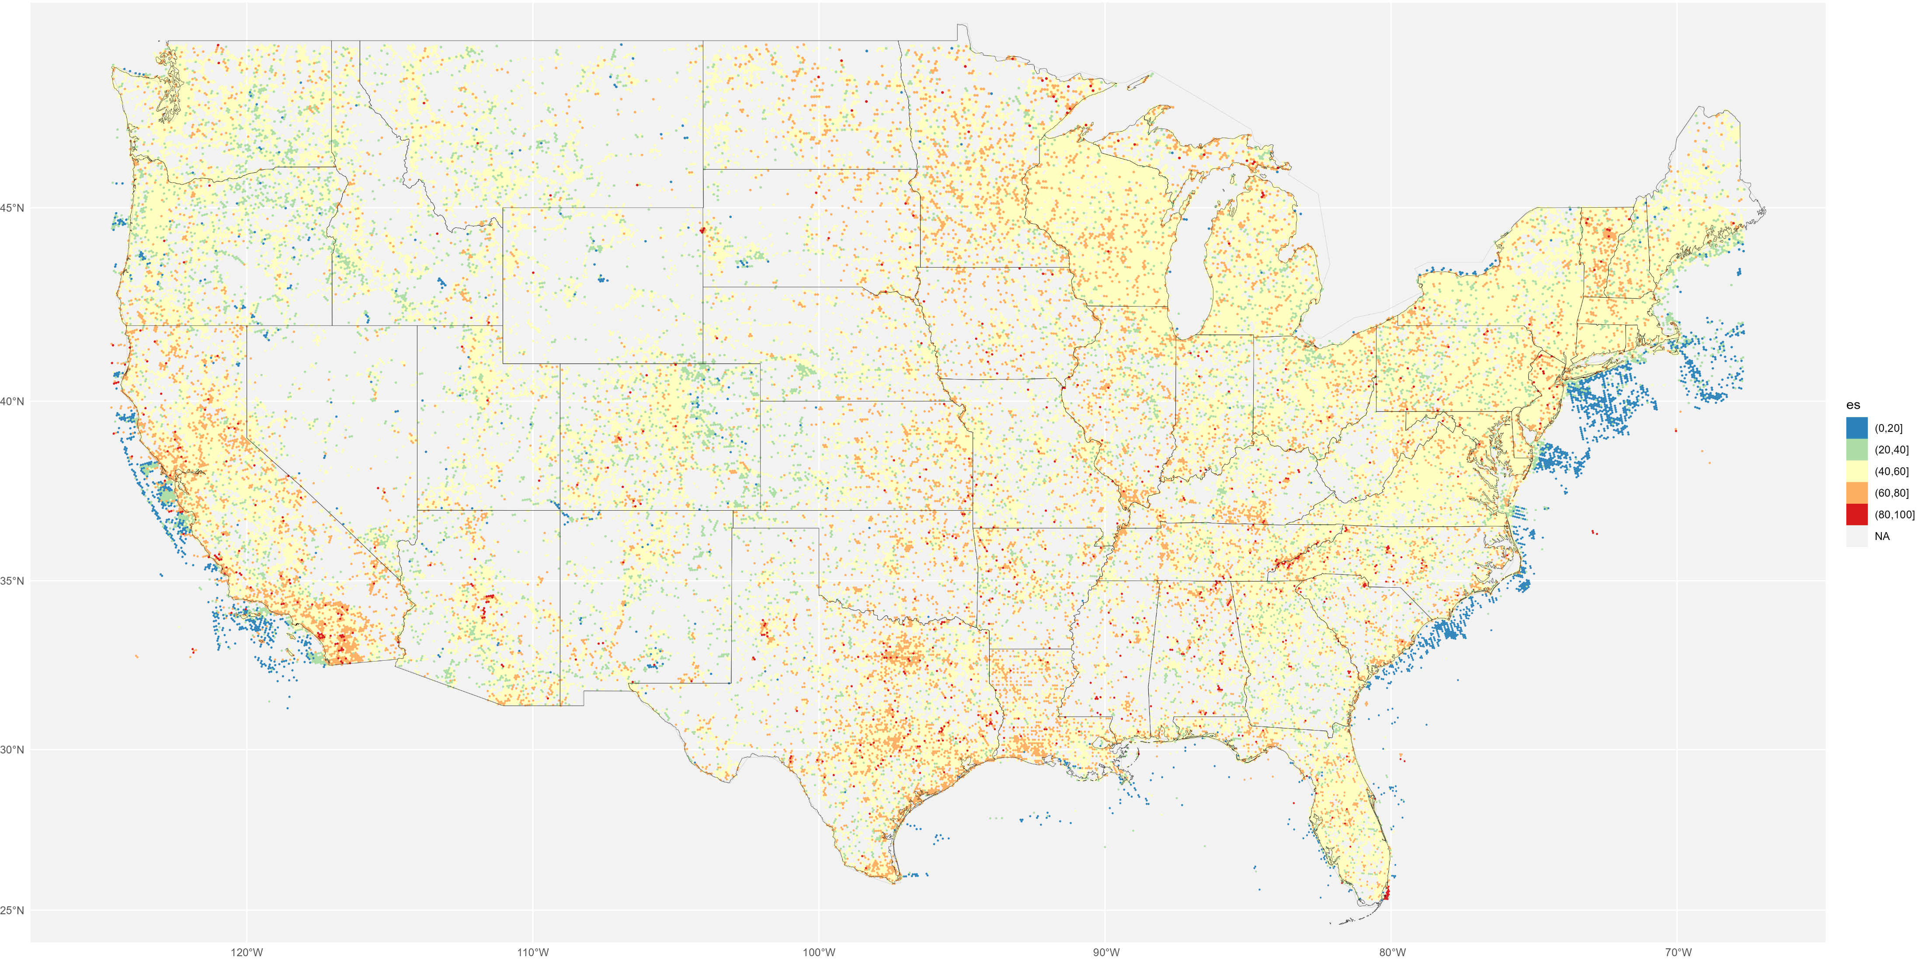
2010s, res 6. ES100

Slide 12

2010s, res 6. ES100 (left) vs ES50 (right)

Slide 13
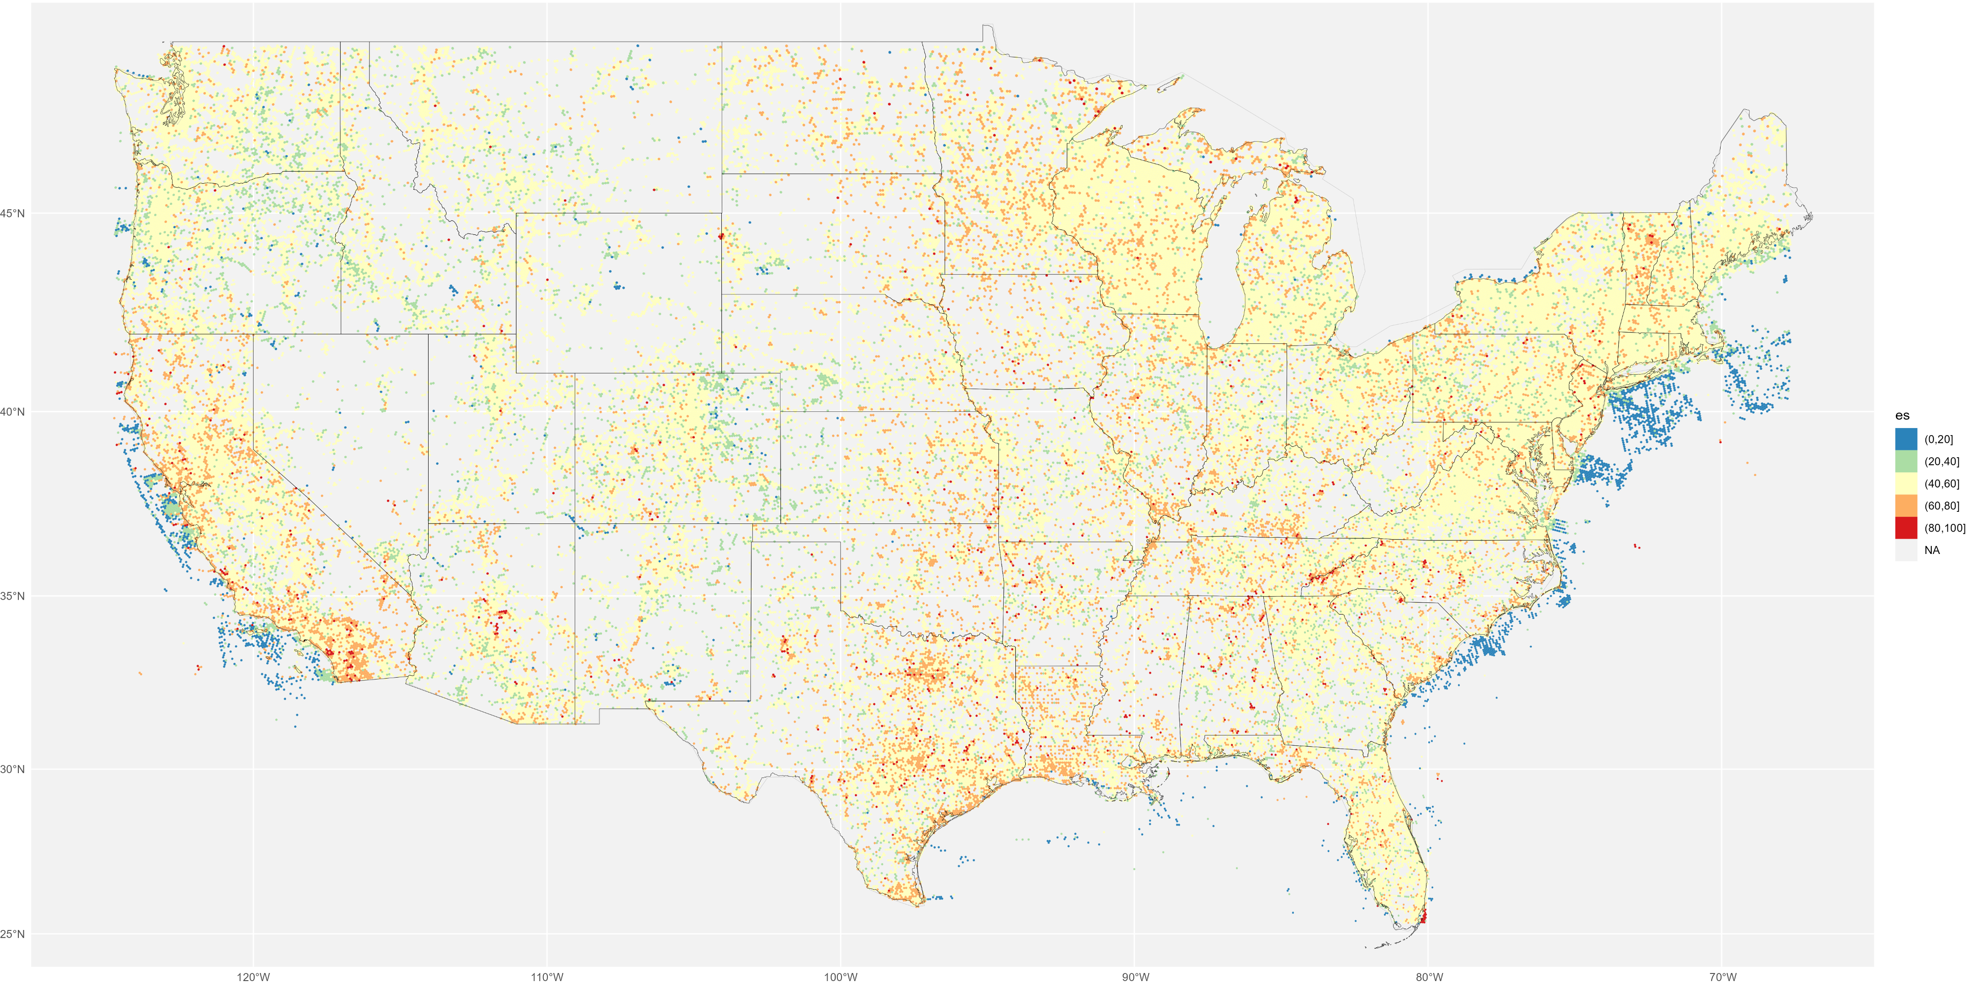
2010s, res 6. left to right: ES100, Shannon, Hill 1 (on bottom)

Slide 14
Runtime on Steve’s GFE for:
2010s (~ 99 million records)
resolutions 1-6
continuous and discrete plots
3 diversity metrics
Section | Wall Minutes
setup | 0.69
spatial_index_of_data | 10.23
diversity_cal | 6.94
plot | 4.83
total_run | 23.79

Slide 15
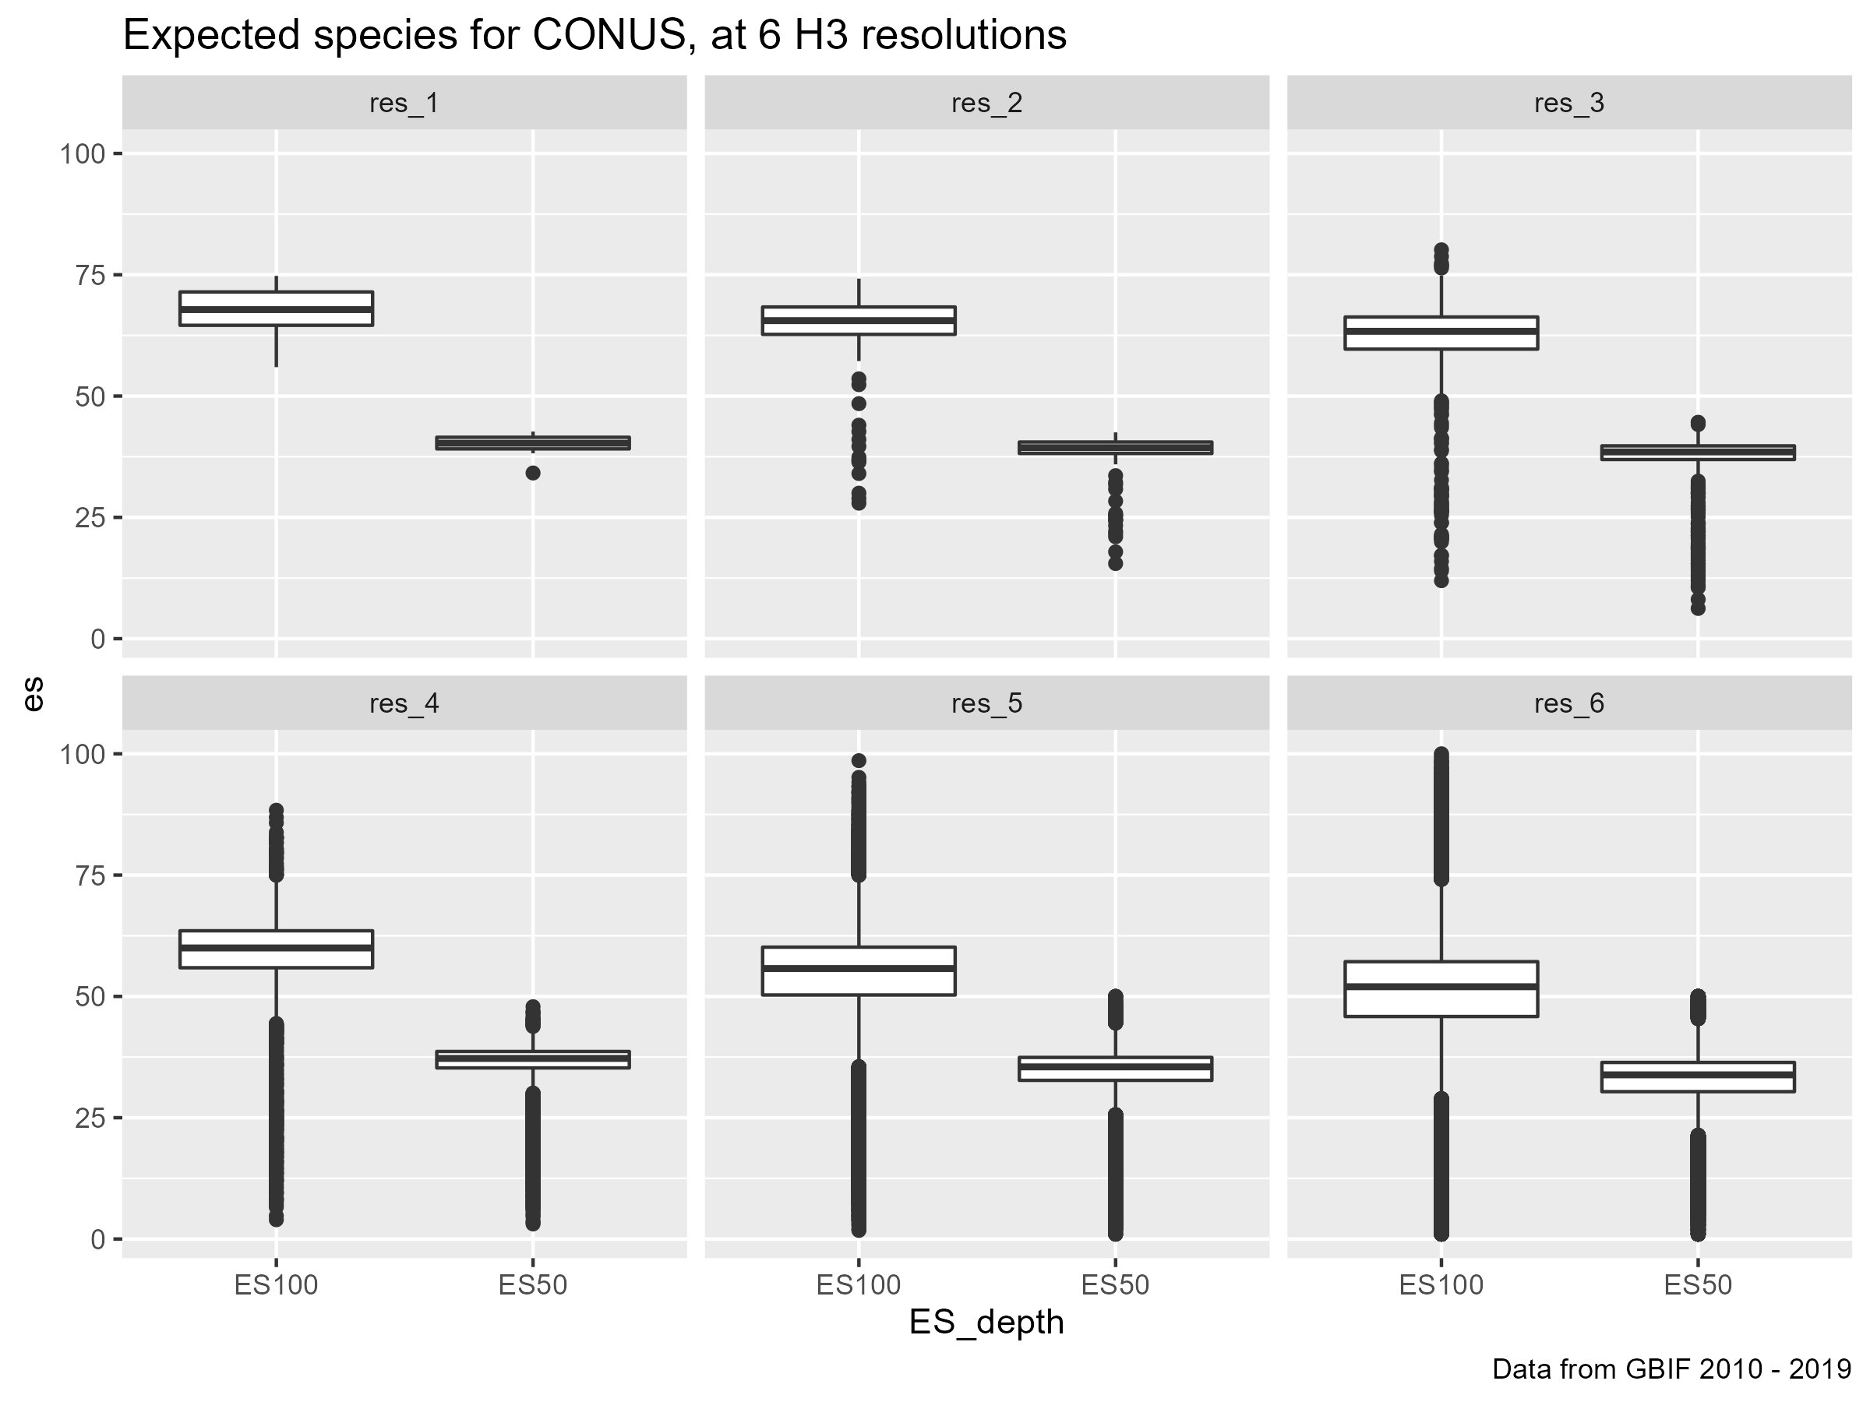

Slide 16
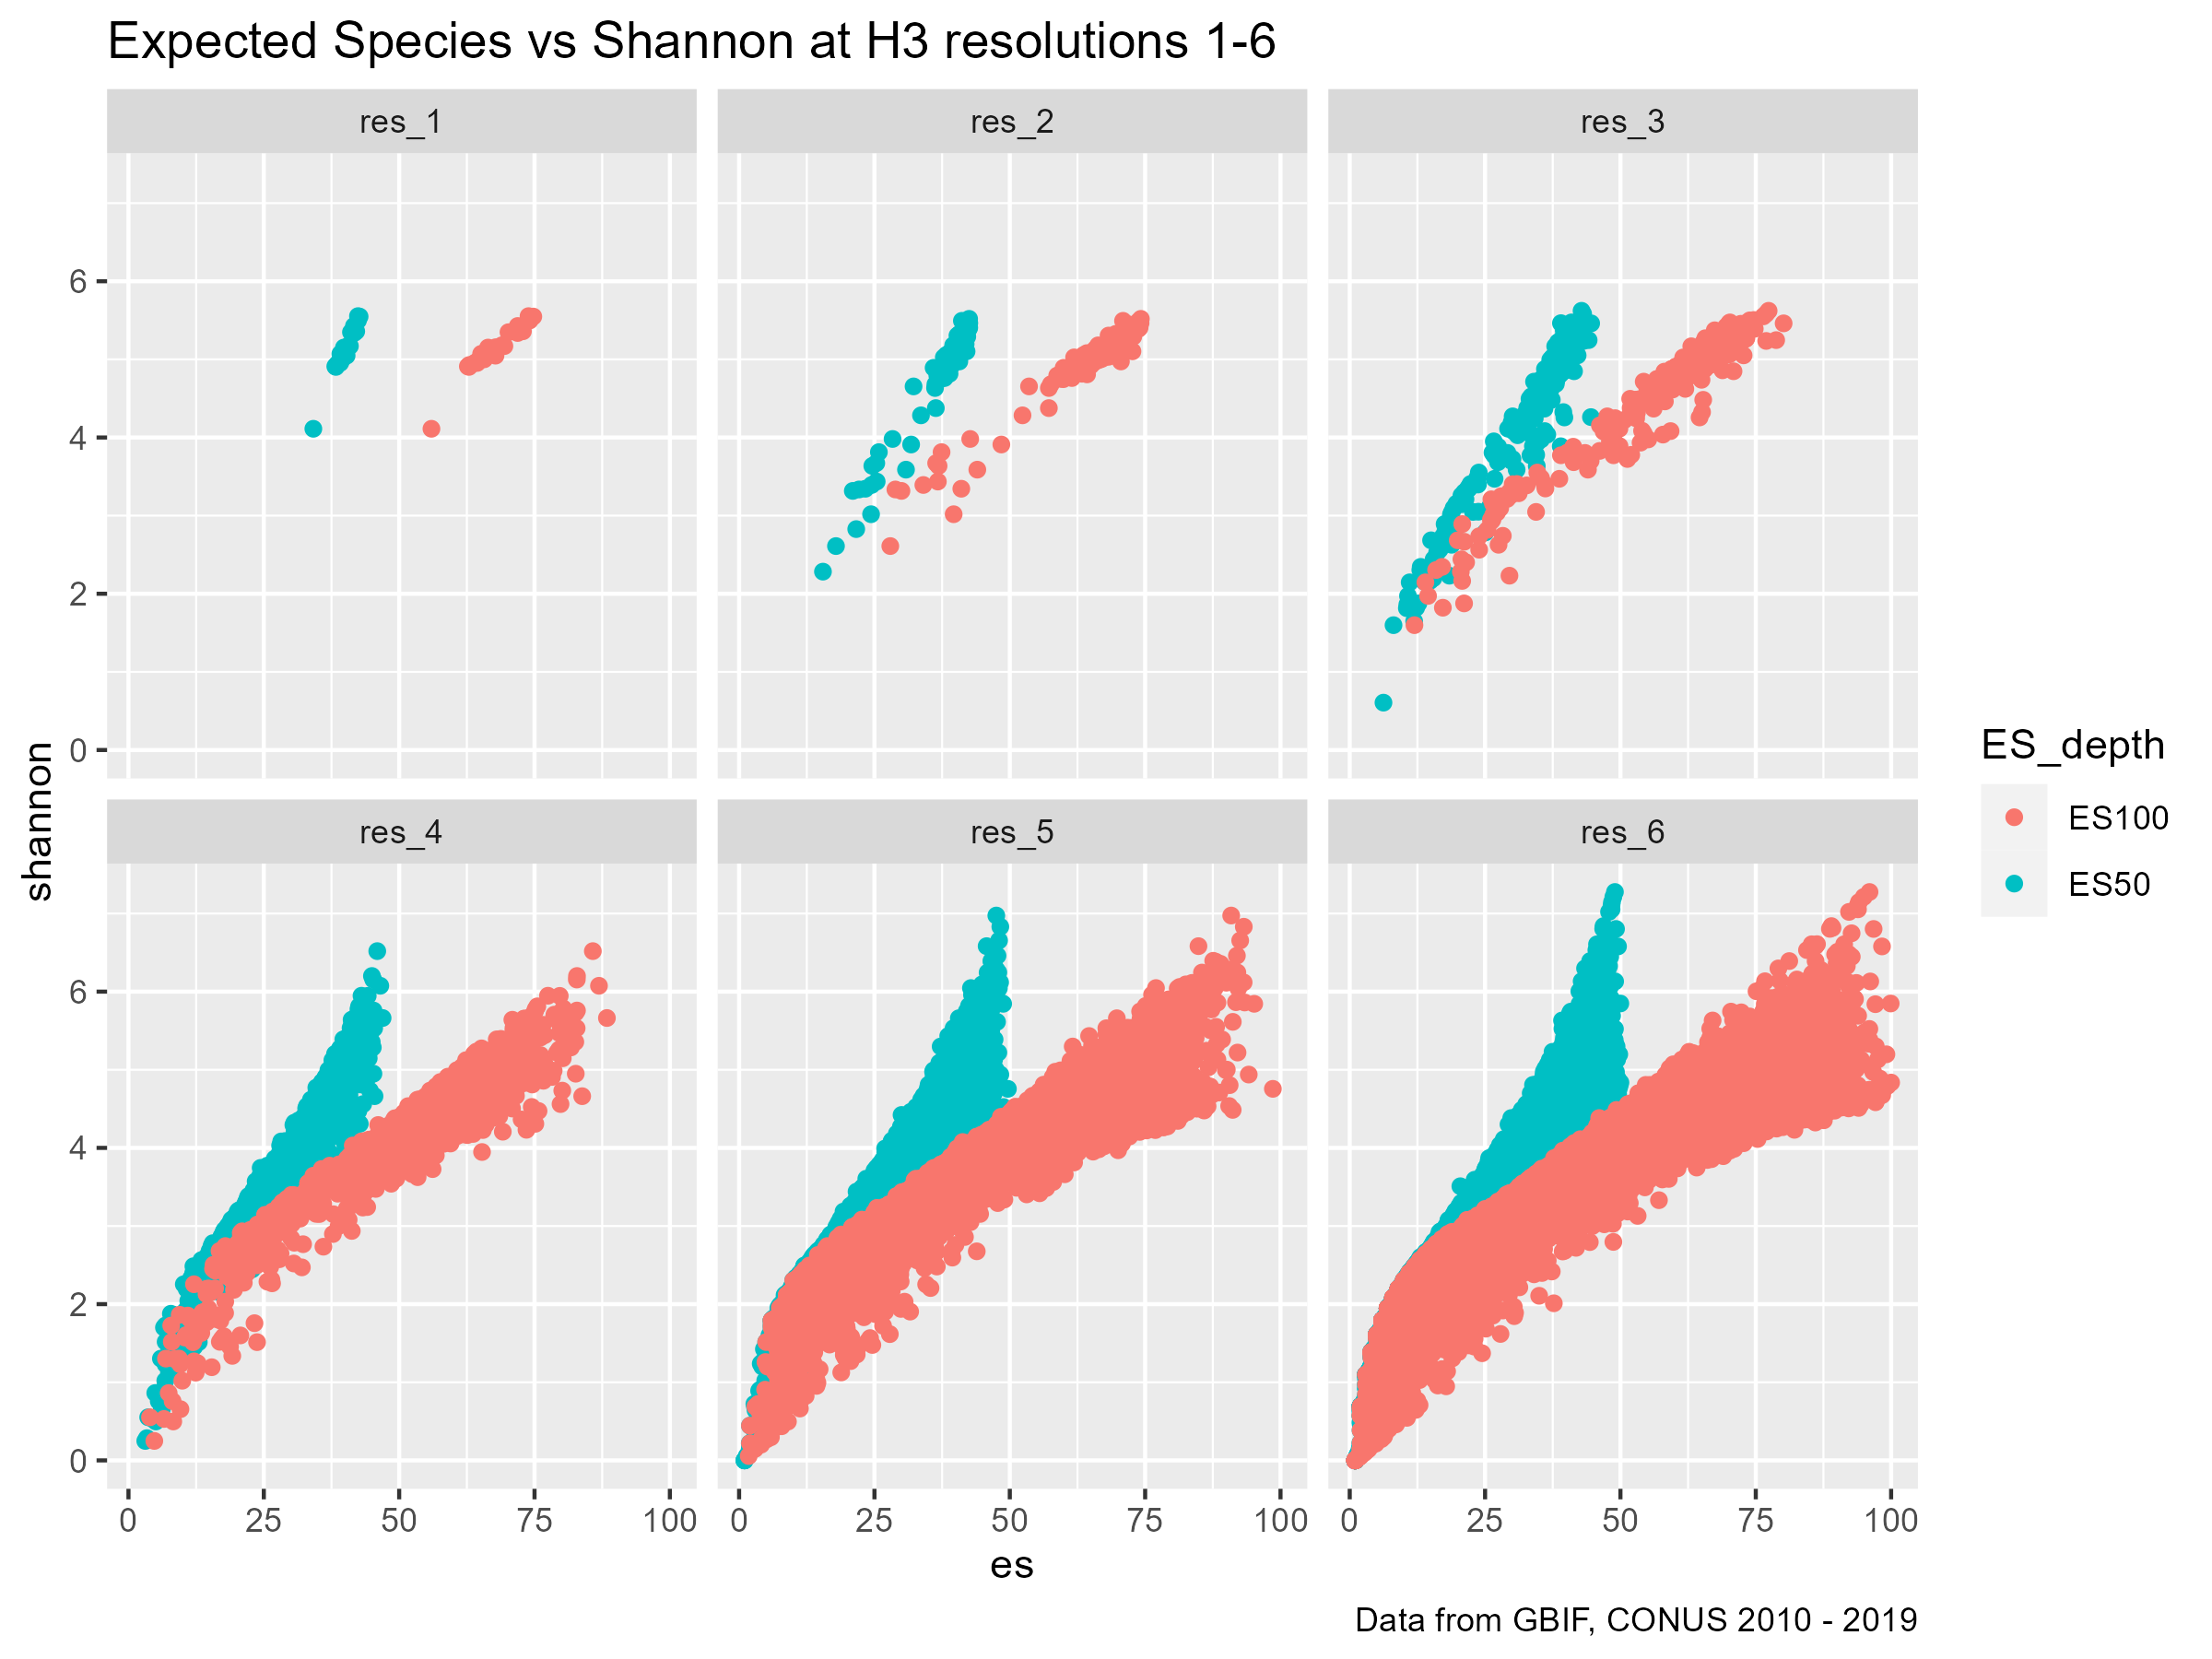

Slide 17
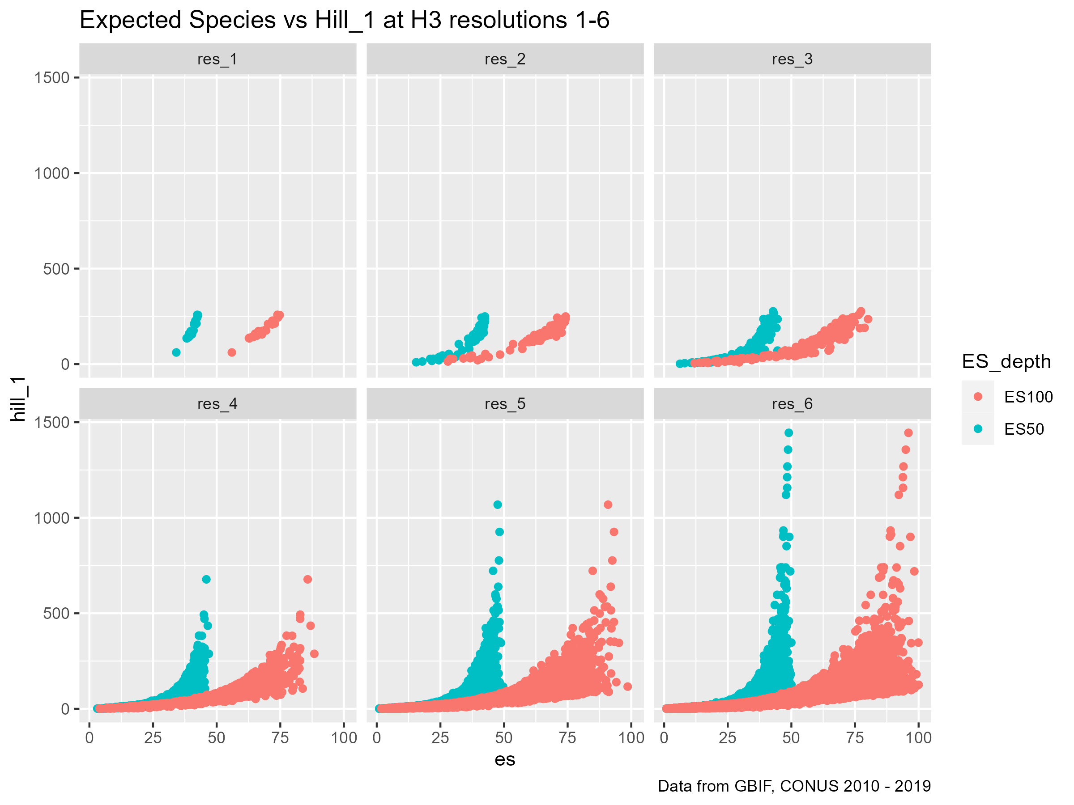

Slide 18
